Slide 1

IMPACT OF CHANGES IN INTEREST RATES IN STOCK MARKET PERFORMANCE
Submitted by:
Neha Bathla
20222MBA0098
MBA 4TH SEMESTER
Under the guidance on
Dr. Aurobindo KS

Slide 2
INTRODUCTION
Interest rates, set by central banks such as the Reserve Bank of India (RBI), are a critical tool of monetary policy and have significant implications for the economy and financial markets. Changes in interest rates influence borrowing costs, consumer spending, business investment, and overall economic growth. Consequently, these changes also have a profound impact on stock market performance. Understanding the relationship between interest rates and stock market dynamics is essential for investors, policymakers, and financial analysts as they navigate the complexities of the financial landscape.

Slide 3
SCOPE
Interest rates are one of an economy's most powerful instruments, directly influencing a wide range of financial activity and overall economic health. The relationship between interest rate changes and stock market performance is complex, diverse, and an important topic of research for economists, investors, and regulators.
Mechanism of Interest Rates influence on Stock Market
Cost of borrowing for companies
Consumer Spending and Corporate Earnings
Investment Allocation Decisions
Sector-Specific Impacts

Slide 4

Objectives
This study is important for investors, policymakers, and companies. Each group can use the information to make better decisions and plan more effectively.
For Investors
Investors can use the findings of this study to make better investment decisions. Understanding how changes in interest rates affect different types of assets allows investors to adapt their portfolios to decrease risk while increasing profits.

Slide 5
For Policy Makers
Policy makers in charge of setting interest rates can use the study to understand how their actions affect the economy as a whole and specific industries. This understanding enables them to develop better policies that promote economic stability and growth.
For Companies
Companies might profit from the study by better planning their financial and investment strategies. Companies that understand how interest rate fluctuations affect their business can make better decisions about borrowing money, investing in new projects, and managing debt.

Slide 6
CASE STUDY - Impact of Interest Rate Changes on the Indian Stock Market during the COVID-19 Pandemic (2020)
In 2020, the COVID-19 pandemic caused a global economic crisis. The Indian economy was hit hard, and the Reserve Bank of India (RBI) took action to support the economy by cutting interest rates.
The Pandemic and Initial Market Reaction
COVID-19 Outbreak: The pandemic began in early 2020, leading to lockdowns and restrictions to control the spread of the virus. This caused a sudden stop in economic activities.
Stock Market Impact: The Indian stock market, like markets worldwide, reacted negatively. The BSE Sensex, a major stock index, dropped sharply in March 2020, falling by about 23% in just a few weeks.

Slide 7
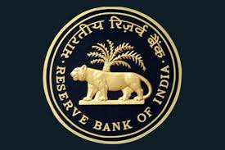
RBI's Response: Rate Cuts and Liquidity Measures
Interest Rate Cuts: To help the economy, the RBI reduced the repo rate (the rate at which the RBI lends money to commercial banks) multiple times. By May 2020, the repo rate was reduced to a historic low of 4%.
Liquidity Measures: The RBI also introduced measures to ensure banks had enough money to lend. This included reducing the cash reserve ratio (CRR), which is the percentage of deposits banks must keep with the RBI.

Slide 8
Impact on the Stock Market
Market Recovery: After the initial drop, the stock market began to recover. By the end of 2020, the Sensex had gained approximately 15% from its March low.
Sectoral Performance:
Technology Sector: Companies in the technology sector performed very well. With more people working from home, there was increased demand for digital services. For example, stocks of IT companies like Infosys and TCS saw significant gains.
Pharmaceutical Sector: Pharmaceutical companies also did well due to the high demand for medical supplies and potential treatments for COVID-19. Stocks of companies like Dr. Reddy's Laboratories and Cipla increased.

Slide 9
WHY DID THE MARKET RECOVER?
Lower Borrowing Costs: The RBI's rate cuts made borrowing cheaper. This helped businesses and consumers by reducing the cost of loans.
Increased Liquidity: The measures taken by the RBI ensured that banks had enough money to lend. This supported businesses and helped maintain economic stability.
Investor Confidence: The actions by the RBI and the government reassured investors that the economic situation would improve, leading to increased investment in the stock market.

Slide 10
RESEARCH METHODOLOGY
We have chosen a mixed-methods approach for this research, combining both quantitative and qualitative methodologies.
Quantitative Analysis: This involves statistical analysis of historical data to identify trends, correlations, and causations.
Qualitative Analysis: Through literature reviews, case studies, and expert interviews, we aim to understand the broader context

Slide 11
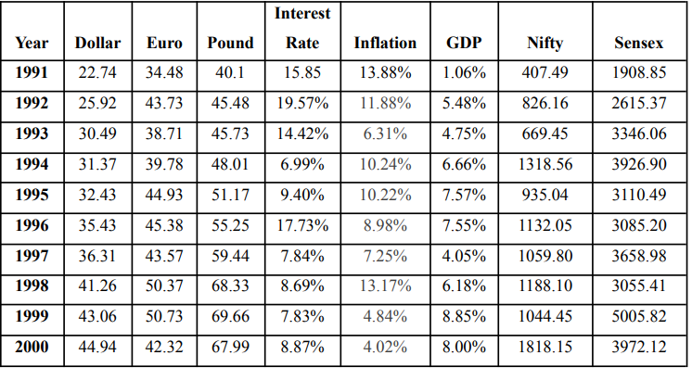
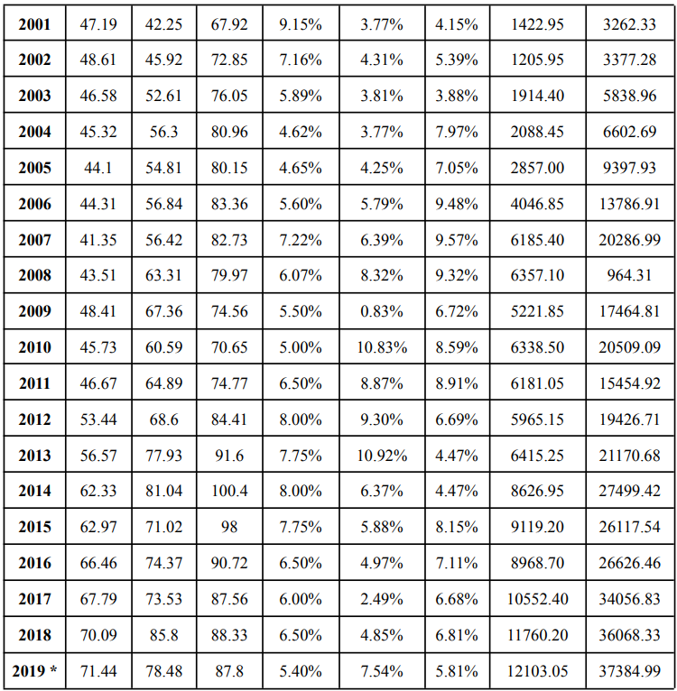
The study has been conducted from the period of 1991 to 2019(Forecast) and by calculating the regression analysis to check the relationship between the independent and dependent factors.

Slide 12
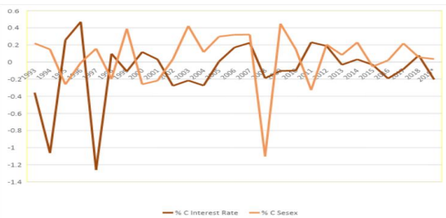
In India, the Reserve Bank of India (RBI) is the central banking institution that determines the interest rate based on the nation's economic condition and requirements. Analyzing data from 1991-2019, we observed a negative correlation between interest rates and Indian stock indices. This means that when interest rates rise, stock prices tend to fall, and when interest rates fall, stock prices tend to rise.
Percentage Change in Sensex and Percentage change in Interest rate (1991-2019)

Slide 13
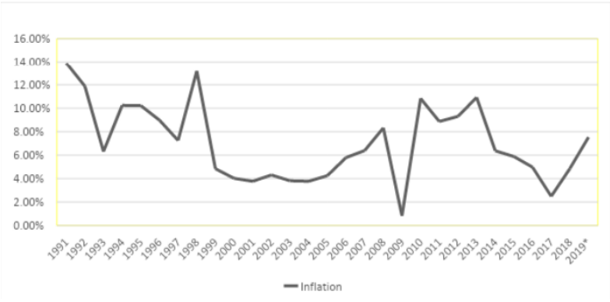
After analyzing data from the period 1991-2019 on inflation and testing secondary data, we observed a moderate negative correlation between inflation and the Indian stock market. Inflation impacts the Sensex less compared to the Nifty. There is an inverse relationship between inflation and the Indian stock market: as inflation rises, the stock market tends to decrease, and vice versa.
INFLATION
Inflation (%) from the period of 1991-2019
This Graph shows the fluctuation in inflation from 1991-2000. “The inflation in the country varies year to year. In 1991 in Indian Inflation = 10.2% whereas in 2000 it was 4.4% which states that the rate was between 10.24% to 4.4%.

Slide 14

FINDINGS
The relationship between inflation and the stock market is weak and inverse, impacting Nifty more than Sensex.
The relationship between the interest rate and the stock market (Nifty, Sensex) is inverse, affecting Sensex more than Nifty.

Slide 15
RECOMMENDATION
For Investors:
Diversify portfolios to hedge against interest rate volatility.
Consider sector-specific investments based on interest rate forecasts.
Monitor central bank announcements and adjust investment strategies accordingly.
For Policymakers:
Maintain transparency in monetary policy to reduce market uncertainty.
Use interest rate adjustments as a tool for economic stability without causing market disruption.
Provide clear guidance on future interest rate paths to help markets adjust smoothly.

Slide 16


